Slide 1
Party Bag Busters

Slide 2
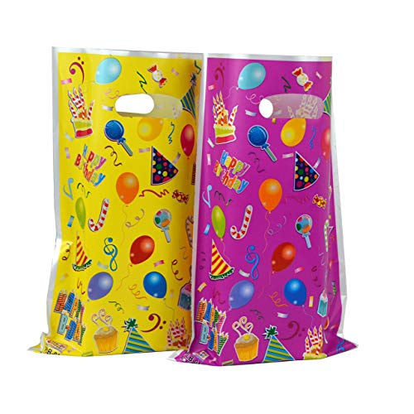

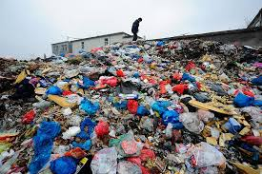
Did you know?
Plastic party bags are single use plastics
We can not recycle them
They do not biodegrade like paper, cloth or wood
We use them for a few minutes but they stay in our environment for centuries

Slide 3

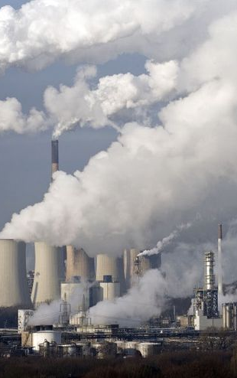
What are party bags made from?
Party bags are made from fossil fuels like petroleum and gas
Petroleum and gas are non renewable. If we don’t stop using fossil fuels, we will be forced to stop as we will run out and cannot make anymore
Removing fossil fuels from the Earth is damaging to the environment
It pollutes the air and our water

Slide 4
Party Bag Statistics
Approx 670,000 4-8 year olds in Ireland
If each one receives 5 party bags this year
670,000 X 5 = 3,350,000

Slide 5
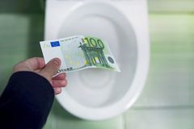
Survey Results
Less than 15% of households reuse party bags
96% are soft plastic
Only one third of children knew that soft plastic party bags cannot be recycled
Over 80% of parents think they are a waste of money

Slide 6


Party Bag Favours
Plastic Toys
More Energy and Pollution
Less than 20% children played with favours for more than a week.
70% of party bag favours went into rubbish bin after one week

Slide 7
What you can do….
Paper Party Bags
Swap Shop
No Party Bags

