Slide 1



Marine Creatures Memory Game
Age Group: Junior and Senior Primary
In the next 2 slides you will find a set of “cards” facing backwards; in the first slide (Level 1!) there are 5 marine creatures represented (10 cards) and in the second one (Level 2) there are 7 marine creatures (14 cards).
Aim: You need to pair-up the cards representing the same creature.
Step 1: Click JUST ONCE on each card to reveal the animal, try to remember what was behind each card (no cheating!)
Step 2: Then – when you know which card to pair-up – click again on the cards that you remember, the second time the card will remain visible. Write down your score and move on to Level 2!
Remember: Play one slide at time
In slides 4 and 5 you will find some curious facts about some of the marine creatures that you found in the game!
When playing we recommend you use “slideshow” (right-hand side of the screen)

Slide 2
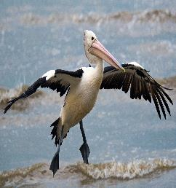
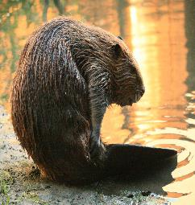
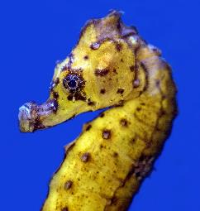
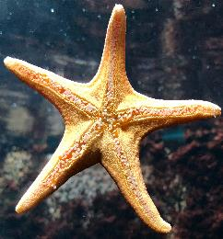

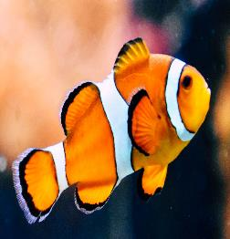

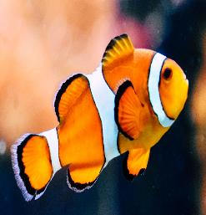
Level 1
Click each card once, memorise the animal, then try to match the pairs! Can you get 5 out of 5?!
?
?
?
?
?
?
?
?
?
?

Slide 3
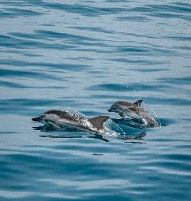
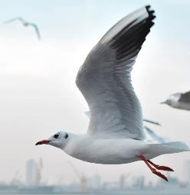
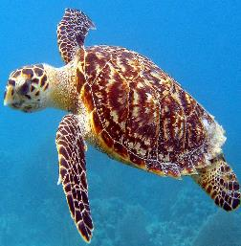
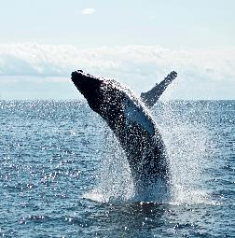
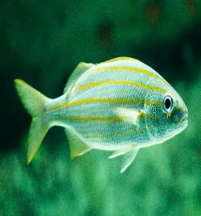
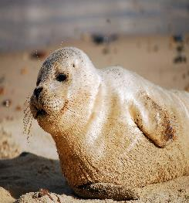
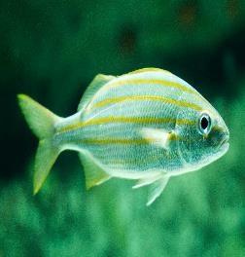

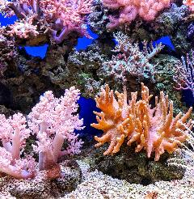



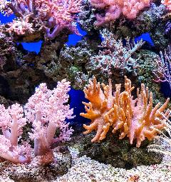

Level 2 – good work so far but can you match all 7?!
?
?
?
?
?
?
?
?
?
?
?
?
?
?

Slide 4


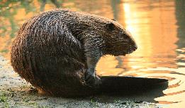
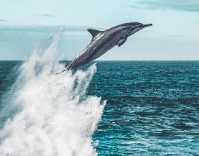
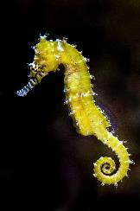
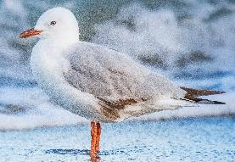
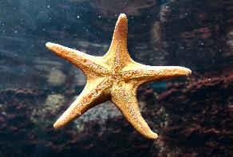
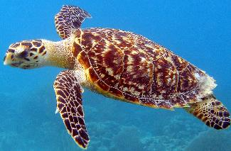
Did you know that…
The beaks of pelicans can hold up to 3 full buckets of fish!
All clown fish are born as males. When the dominant female of a group dies the largest male will turn itself into a female.
The tail of beavers is multipurpose: they use it both to swim and to warn others of predators!
Dolphins communicate with each other by clicking, whistling and other sounds.
Seahorses have no teeth and no stomach. Food passes through their digestive systems so quickly, they must eat almost constantly to stay alive.
Seagulls can drink both fresh and saltwater thanks to special glands right behind their eyes!
Starfish have no brain and no blood; they use filtered sea water to pump nutrients through their nervous system.
Sea turtles live about 100 years, and that's also roughly the amount of eggs they lay every time they nest!

Slide 5
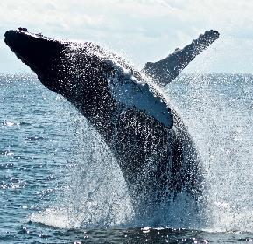
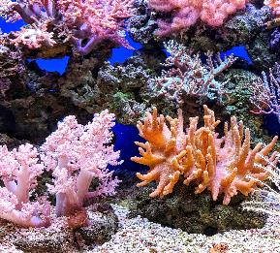
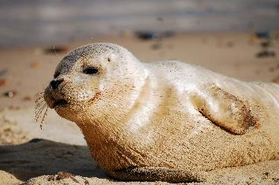
Did you know that…
The blue whale is the largest animal that ever lived and weighs as much as 24 elephants!
Corals are animals, not plants! They are relatives of jellyfish and anemones!
Some seal species can hold their breath for nearly two hours underwater!

