Slide 1


Plaisteach
Plaisteach - Céard é féin, cén chaoi a n-úsáidimid é agus cé na tionchair a bhíonn aige ar an gcomhshaol
Acmhainn Mheánscoile

Slide 2

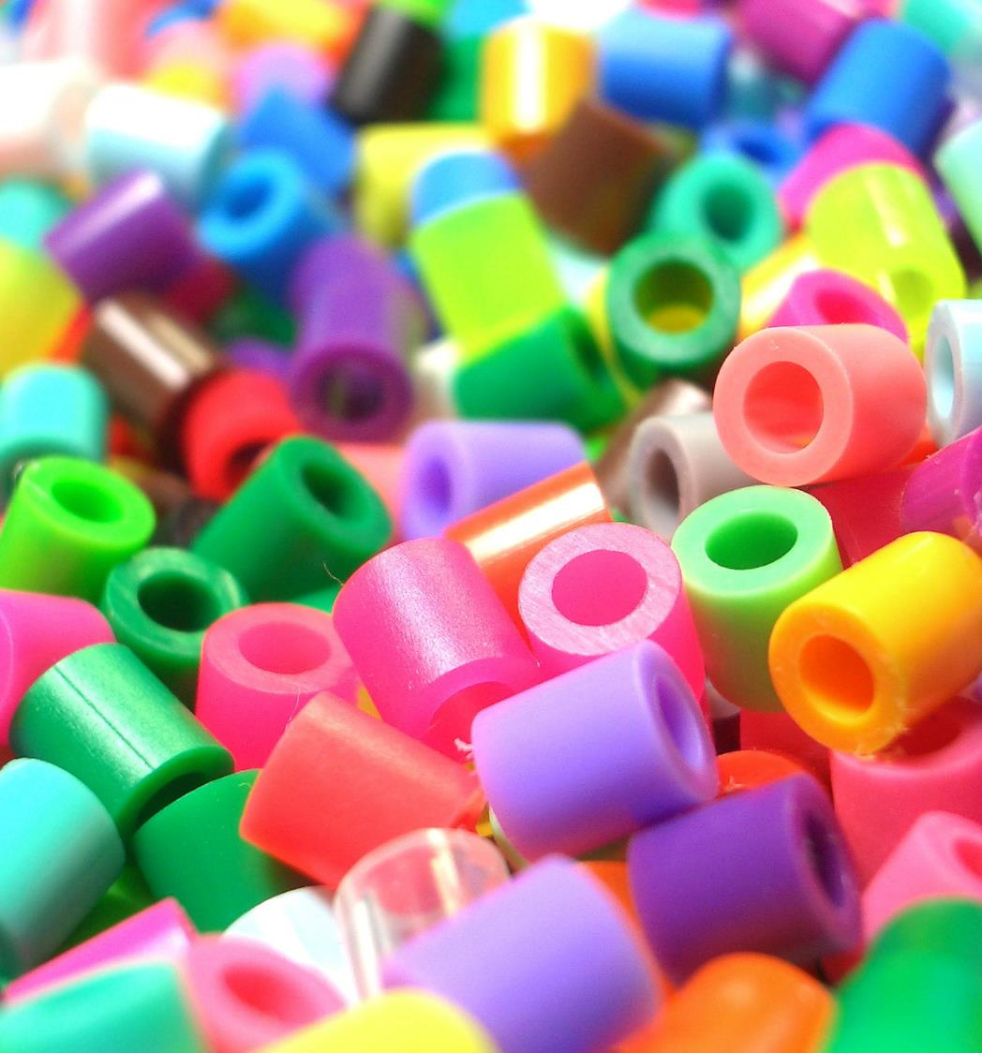
Céard is plaisteach ann?
Is ábhar é plaisteach a tháirgtear ó ola trí phróiseas ceimiceach agus a úsáidtear le go leor rudaí a dhéanamh
Tagann an téarma ón bhfocal plastikos i nGréigis, a chiallaíonn “rud is féidir a mhúnlú”.
Rinneadh an chéad phlaisteach sintéiseach in 1907
Anois tá níos mó ná 50 cineál plaistigh ann
Notes:
Can you name any types of plastic?
Polyethylene Terephthalate (PETE or PET)
High-Density Polyethylene (HDPE)
Polyvinyl Chloride (PVC)
Low-Density Polyethylene (LDPE)
Polypropylene (PP)
Polystyrene or Styrofoam (PS)
Polycarbonate
Acrylic,
Fiberglass
Nylon

Slide 3
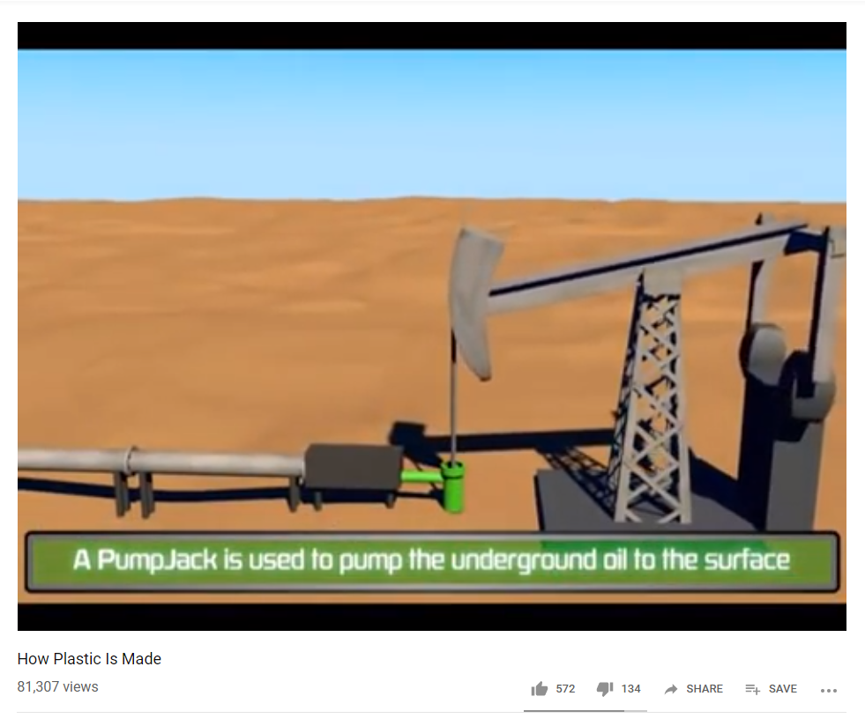
Cén chaoi a ndéantar plaisteach?
https://www.youtube.com/watch?v=w4VG-7ZFvDM
Notes:
Plastics are made from crude oil. Crude oil is a complex mixture of thousands of compounds and needs to be processed before it can be used. The production of plastics begins with the distillation (separation) of crude oil in an oil refinery. This separates the heavy crude oil into groups of lighter components, called fractions, or hydrocarbons. Each fraction is a mixture of hydrocarbon chains (chemical compounds made up of carbon and hydrogen), which differ in terms of the size and structure of their molecules. One of these fractions, naphtha, is the crucial compound for the production of plastics.
Hydrocarbons made in this way are the raw materials for polymerization, the name we give to the chemical reactions that make polymers. Polymers are made by joining hydrocarbon monomers together, like daisy chains, or by joining together two small hydrocarbon chains and removing a water molecule (two hydrogen atoms and one oxygen). By joining more and more together, the longer the polymer gets.
Catalysts are usually added to kick start the polymerisation reaction. Plastics often have other ingredients added to the basic hydrocarbons to produce a polymer with exactly the right chemical and physical properties. These extra ingredients include colorants (to change the plastics colour), plasticizers (which make plastics more flexible, viscous, and easier to shape), stabilizers (to stop plastics degrading in sunlight and heat), and fillers (typically low-cost minerals that mean we need less of the expensive, oil-based hydrocarbons to make our final plastic product—so we can make and sell it more cheaply).
At this point, the plastic polymer is known as a resin, which can be used for making all kinds of plastic products. Resins are supplied as powders or grains that are loaded into a machine, heated, and then shaped by one or more processes to make our finished plastic product. The shaping processes include injection and blow molding (where we squirt hot plastic through a nozzle into a mold to make things like plastic bottles), calendering (squashing between heavy rollers, for example, to make plastic sheets or films), extruding (squeezing plastic through a nozzle, perhaps to make pipes or straws), and forcing plastics through a kind of microscopically small sieve, called a spinneret, to make thin fibres (which is how fibres are made for things like toothbrushes or nylon stockings).
Video: https://www.youtube.com/watch?v=w4VG-7ZFvDM

Slide 4
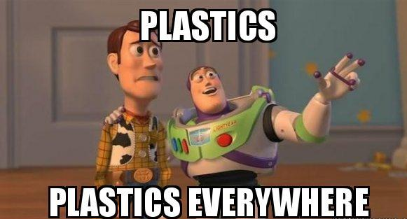
Notes:
How plastic is your life? Partner up and make a list of ten plastic things you use in your life every day.
Hints:
Plastic toothbrush
Plastic milk carton
Plastic hair gel container
Plastic fibres in your clothes
Plastic lunch box
Plastic packaging on your food
Plastic frame on your television
Plastic on your phone charger

Slide 5
An bhféadfá maireachtáil gan an plaisteach?
Éadaí
Pacáistíocht
Earraí leictreonacha
Iompar
Soláthairtí leighis
Áineas
Notes:
Clothing: Polyester, nylon, acrylic, and other synthetic fibres (all of which are forms of plastic) are now about 60 percent of the material that makes up our clothes worldwide. Soccer jerseys are made from nearly 100% polyester. Sweat ‘wicking’ fabrics used in sports apparel and gym gear are usually made of polyester and/or Lycra blends.
Packaging: The commercial success of plastics as a packaging product is due to its range of flexibility (from film to rigid applications), strength, lightness, stability, impermeability and ease of sterilisation. These features make plastics an ideal packaging material for all different products. Plastic food packaging, for instance, does not affect the taste and quality of the food within. In fact, the barrier properties of plastics ensure that food keeps its natural taste while protecting it from external contamination. Moreover its unparalleled versatility is demonstrated in a multitude of applications such as packaging films for fresh meats, bottles for beverages, edible oils and sauces, fruit yoghurt cups or margarine tubs.
Automobiles: Cars are filled with plastics- from the engine to the radio. Some cars can consist of over 50% plastic. Safety advances in cars using plastics save lives. Air bags, windshields, sunroofs plus energy absorbing innovations are some examples. Plastic front-end modules, modular seats and energy-absorbing bumpers help save lives every year. Car manufacturers are increasingly relying on high-temperature plastic car parts to help reduce weight and cost, increase parts integration and provide for longer service life of cars.
Electronics: From simple cables and household appliances (food blender. Nutribullet, microwave, toaster) to smartphones, many of the latest devices created in the Electrical & Electronic sector capitalize on new generation plastics. Thanks to its ability to be moulded into any shape and versatility, plastics contribute significantly to innovation in the electrical and electronic sector.
Aircrafts: Commercial flights would be a lot more expensive and modern warfare jets would pose less threat to the enemy without plastic materials. Since 1970, the use of aerospace plastics has quadrupled. Interior components (like overhead bins), components for navigational and propulsion functions, and structural elements can all be made out of plastic components. Military aircraft also benefit from the use of plastics. They make aircraft lighter, which extends flight range and helps the jet to evade radar detection.
Medical supplies: Disposable plastic products include: medical bags, syringes, kits, labware, tubing, catheter and intravenous (IV) units, gloves, trays, and utensils, among others. Major nondisposable plastics include: testing and diagnostic equipment, surgical instruments or related equipment, prostheses and implants, and dental and ophthalmic materials.
Recreational items: From the tracks on which Olympic athletes pursue new records to the shoes, clothing and safety equipment they wear and the stadia they perform in, modern sports rely on plastics. Footballs, goal nets, corner flags, shin pads, football boots and jerseys are all made with plastics. Toymakers have been using plastics to make some of the best known and most popular toys for children (Lego, Barbie dolls, power rangers etc.)

Slide 6
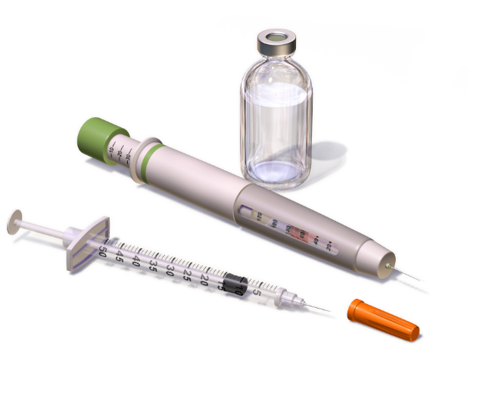
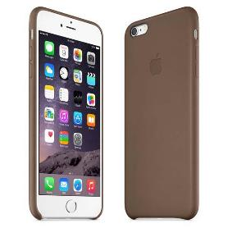
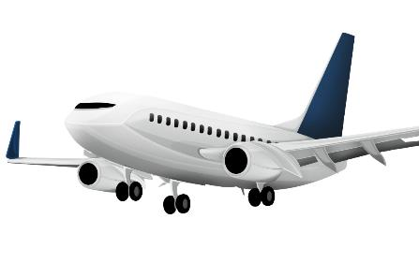
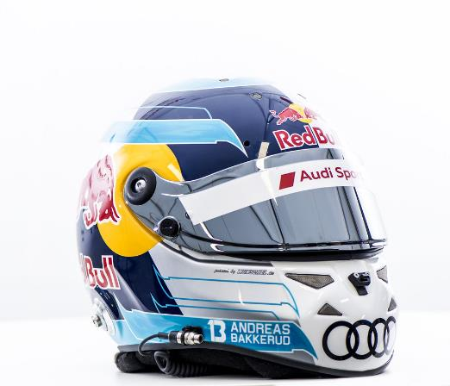
Is í an fhírinne... gurb iontach an rud é an plaisteach
Láidir
Saor go leor
Marthanach
Éadrom
Uiscedhíonach
Is féidir é a mhúnlú in aon chruth
Notes:
Plastic are sterile and strong and everywhere around us. They are used in everything from food containers to shoe soles to the cars we drive. Our telephones, our carpets, and even the fleece we’re wearing all may contain plastic. We store our food in it, drink water from it, and even brush our teeth with it. It’s cheap, convenient, and versatile.
The benefits of plastics are unmatched by any other material. It is light, easily shaped, strong, and inexpensive. Its ability to guard against contamination makes it useful in sterile medical environments such as hospitals. Plastic kitchenware offers a practical alternative to glass and ceramic dishes. Plastic preserves flavour and freshness when used to store food and beverages. Leak-proof and child-resistant plastic containers are useful for holding dangerous household products such as bleach, ammonia, and other toxic cleaning chemicals.
Plastic packaging withstands the rigors of shipping, and plastic containers provide good storage solutions at home and in the office. It seems that the benefits of using plastic are boundless–but are they really?

Slide 7
Ach déanann an plaisteach dochar don chomhshaol
An fad ama a thógann sé ar earraí briseadh síos:
Málaí plaisteacha: 500-1000 bliain
Buidéil phlaisteacha: 70-450 bliain
Bróga leathair: 25-40 bliain
Toitín: 1-12 bhliain
Cartán bainne: 5 bliana
Cadás: 1-5 mhí
Notes:
Unlike natural materials like cotton or food waste, plastic takes a long time to breakdown. In fact, it never really degrades, it just breaks up into smaller and smaller pieces. The inability to biodegrade means plastic is a huge contributor to the waste problem on our planet. The worlds plastic production reached almost 350 million tonnes in 2017. Packaging is the dominant generator of plastic waste, responsible for almost half of the global total production.
Source: https://www.down2earthmaterials.ie/2013/02/14/decompose/

Slide 8
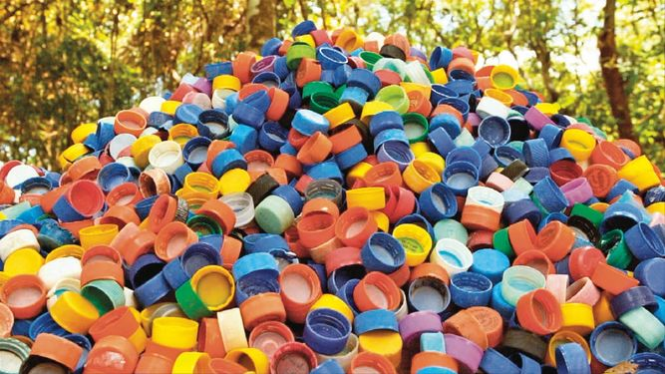
Tá plaistigh aonúsáide níos measa fós.
Plaistigh iad sin atá deartha lena n-úsáid uair amháin.
Teastaíonn a lán fuinnimh agus acmhainní le plaistigh a dhéanamh.
Bíonn plaistigh nach bhfuil deartha lena n-úsáid ach uair amháin ina gcúis le cuid mhaith dramhaíola
Notes:
Single-use plastics, or disposable plastics, are used only once before they are thrown away or recycled. These items are things like plastic bags, straws, coffee stirrers, soda and water bottles and most food packaging
Source of graphic: https://www.vision.org/environmental-sustainability-use-reuse-recycle-5669

Slide 9

An féidir leat smaoineamh ar roinnt samplaí de phlaistigh aonúsáide?
Notes:
Examples of single use plastics:
Plastic bags
Straws
Coffee stirrers
Water bottles
Plastic cutlery
Coffee cups
Plastic cups
Coffee cup lids
Plastic food packaging

Slide 10
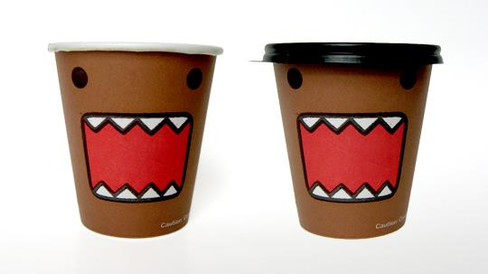

Notes:
Globally it is estimated that 500 billion disposable cups are discarded to landfill or incineration every year. That’s one million cups a minute, every hour of every day of every year. These cups are virtually impossible to recycle due to the combination of plastic and paper in their design, and in Ireland we estimate that we dispose of over 22,000 of these non-recyclable cups every hour.
Video https://youtu.be/k133eRJM6yg

Slide 11

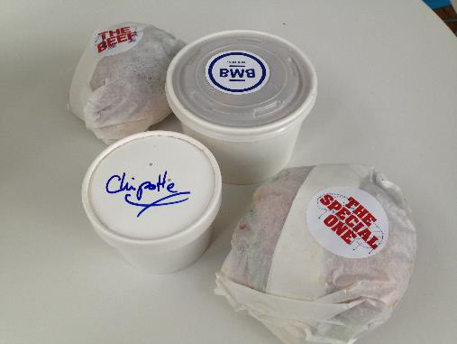
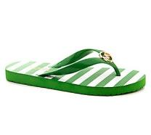
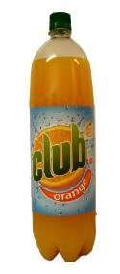

Ceannaigh é, úsáid é, caith amach é?
Déan machnamh ar na rudaí a cheannaíonn tú
Smaoinigh ar inbhuanaitheacht na n-ábhar a úsáidtear sna táirgí sin
Tomhaltachas: mian an duine le táirgí agus earraí a bheith aige de bhreis ar a riachtanais bhunúsacha féin
An bhfuil roghanna eile ann a d’fhéadfaí a úsáid in ionad na dtáirgí plaisteacha seo?
Notes:
For example,

Slide 12
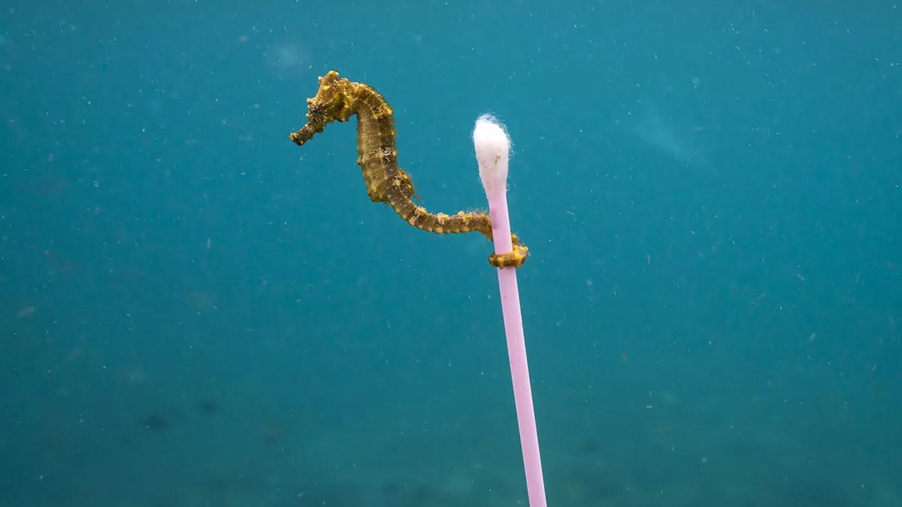
Cás-staidéar: Plaistigh san Aigéan
© J. Hofman
Notes:
Image source: Justin Hofman https://www.theverge.com/2017/9/15/16314928/justin-hofman-seahorse-plastic-pollution-photography

Slide 13
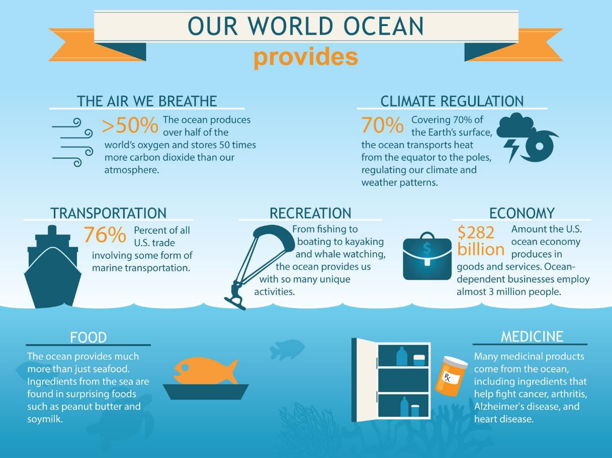
Notes:
You may not realise it, but the oceans are playing a massive role in your every day life. Half of the oxygen we breathe comes from the marine plants like seaweed and phytoplankton, Irelands climate is regulated by the oceans and most of the goods we import are transported via the seas.

Slide 14
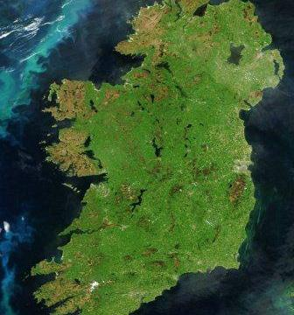
Staitisticí Muirí na hÉireann
Tá os cionn 3,000 ciliméadar cósta agus 220 milliún acra talún faoi bhun na farraige ag Éirinn.
Tá 24 speiceas céiticeach (míolta móra agus deilfeanna) in Éirinn
Tá 71 speiceas siorcanna ina gcónaí in uiscí na hÉireann
Meastar go bhfuil os cionn 30,000 longbhriseadh amach ó chósta na hÉireann
I gCluichí Oilimpeacha 2016, bhuaigh Éire trí bhonn airgid i spóirt mhuirí (rámhaíocht agus seoltóireacht)
Baintear úsáid as feamainn a bhaintear in Éirinn i leigheasanna ar shlaghdán agus fliú, agus mar chomhábhar in uachtar reoite

Slide 15
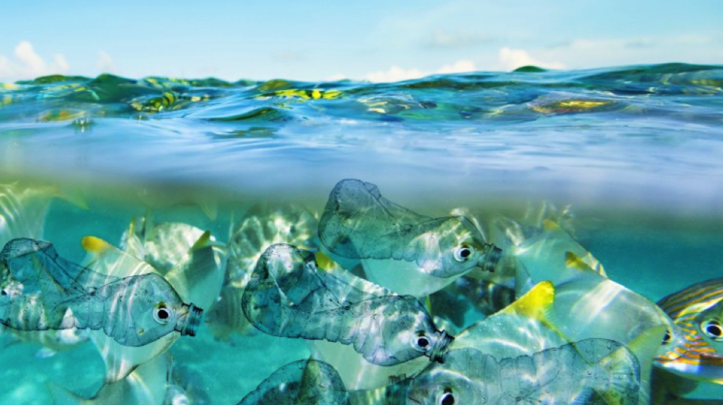
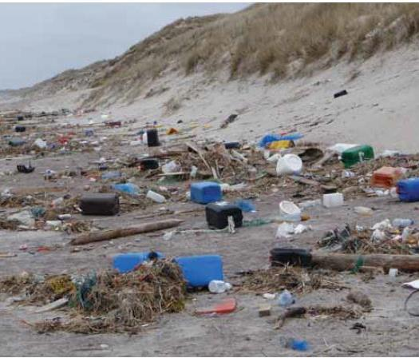
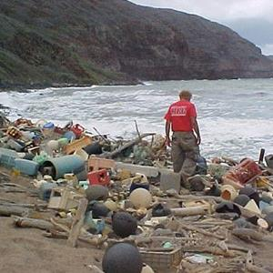
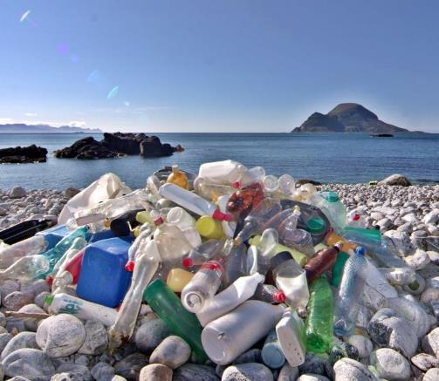
Tá bruscar muirí ag déanamh dochar do shláinte ár n-aigéan
Notes:
Marine litter is a global issue. Just walk along your local beach, and your guaranteed to find plastic waste along the shore. Only 15% of marine litter is washed up on our shores, another 15% is floating in the water column, but 70% is on the seafloor. Marin litter can damage coral reefs, strangle marine mammals and leach toxic chemicals into the seawater and surrounding wildlife. What is this marine litter made up of? And where does it come from?

Slide 16
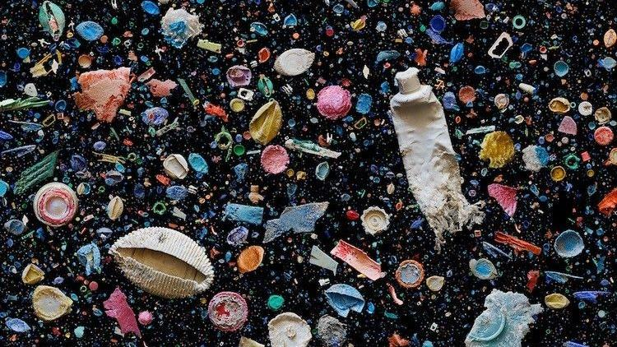
Bruscar muirí – na fadhbanna is mó
Bunanna toitíní
Buidéil phlaisteacha
Caipíní plaisteacha buidéil
Cumhdaigh bhia
Málaí plaisteacha
Claibíní plaisteacha
Soip phlaisteacha
Buidéil ghloine
Málaí plaisteacha eile
Coimeádáin Styrofoam
Notes:
Photo: Mandy Barker
Source of data: https://oceanconservancy.org/news/top-ten-items/

Slide 17
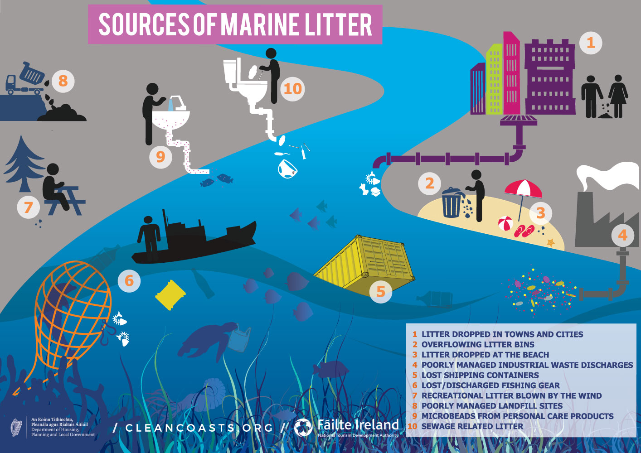
Notes:
Where does marine litter come from?
Plastic in our oceans can arise from both land-based or marine sources. Plastics pollution from marine sources refers to the pollution caused by fishing fleets that leave behind fishing nets, lines, ropes, and sometimes abandoned vessels. There is often intense debate about the relative importance of marine and land sources for ocean pollution. At the global level, best estimates suggest that approximately 80 percent of ocean plastics come from land-based sources, and the remaining 20 percent from marine sources
Source: https://cleancoasts.org/

Slide 18
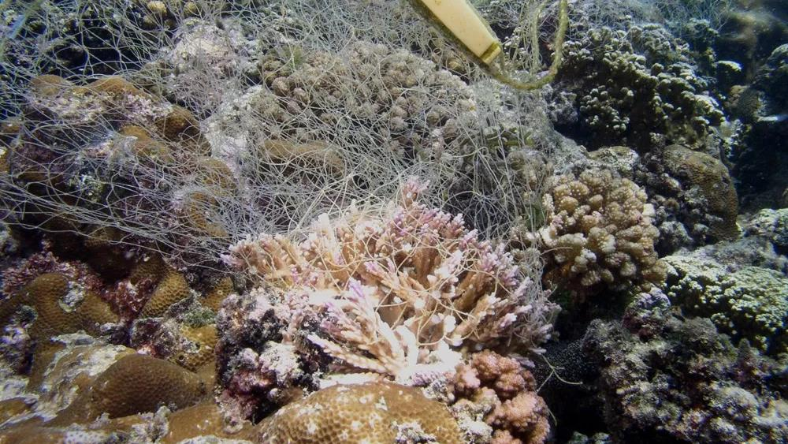
Is féidir le plaistigh bualadh faoi ainmhithe mara agus iad a scrabhadh
Notes:
Contact with plastic litter can result in collisions, obstructions, and abrasions to marine life. For example, fishing gear such as nets has been shown to cause abrasion and damage to coral reef ecosystems upon collision. Ecosystem structures can also be impacted by plastics following interference of substrate with plastics (impacting on light penetration, organic matter availability and oxygen exchange). For example, seaweeds need light to carry out photosynthesis and produce oxygen. If a large plastic sheet covered the seaweed it would no longer be able to photosynthesise.

Slide 19
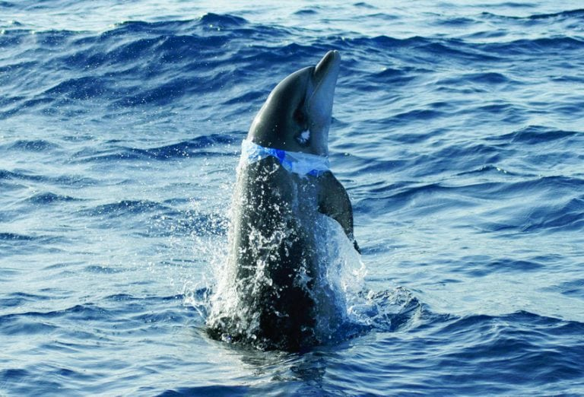
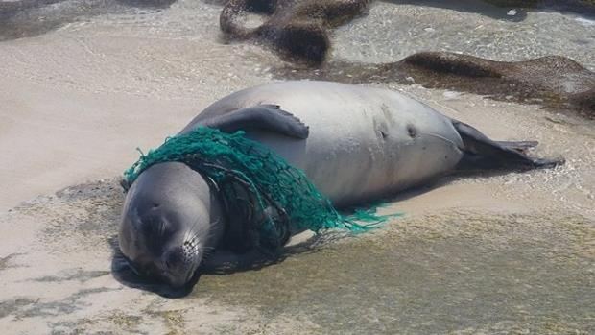
Is féidir le plaistigh ainmhithe a chur i bhfostú, a thachtadh agus a phlúchadh
Notes:
Plastic waste can entrap, encircle or constrict marine animals. Entanglement cases have been reported for at least 344 species to date, including all marine turtle species, more than 66% of seal species, 30% of whale species, and 25% of seabirds. Entanglement by 89 species of fish and 92 species of invertebrates has also been recorded.
Entanglements most commonly involve plastic rope and netting and abandoned fishing gear. However, entanglement by other plastics such as packaging have also been recorded.
Source of data: https://ourworldindata.org/plastic-pollution
Photo source: https://uk.whales.org/2019/04/02/nature-may-have-the-answer-to-plastic-pollution/

Slide 20
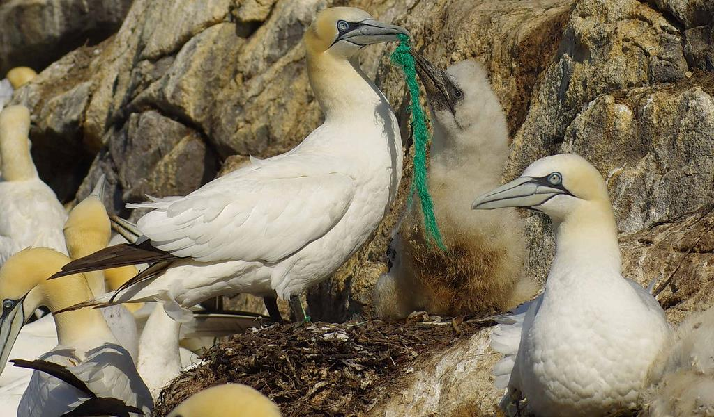
Is féidir le hainmhithe plaisteach a ithe agus iad ag ceapadh gur bia é
Notes:
A mother Gannet feeds her chick with plastic rope
Ingestion of plastic can occur unintentionally, intentionally, or indirectly through the ingestion of prey species containing plastic. Ingestion of plastic has now been documented for at least 233 marine species, including all marine turtle species, more than one-third of seal species, 59% of whale species, and 59% of seabirds. Ingestion by 92 species of fish and 6 species of invertebrates has also been recorded.
The size of the ingested material is ultimately limited by the size of the organism. Very small particles such as plastic fibres can be taken up by small organisms such as filter-feeding shellfish like oysters or mussels; larger materials such as plastic films, cigarette packets, and food packaging have been found in large fish species; and in extreme cases, documented cases of sperm whales have shown ingestion of very large materials including 9 m of rope, garden hose, two flowerpots, and large amounts of plastic sheeting.
Ingestion of plastics can have multiple impacts on organism health. Large volumes of plastic can greatly reduced stomach capacity, leading to poor appetite and false sense of satiation leading animals to ultimately starve to death. Plastic can also obstruct or perforate the gut, cause ulcerative lesions, or gastric rupture which can also lead to death.

Slide 21
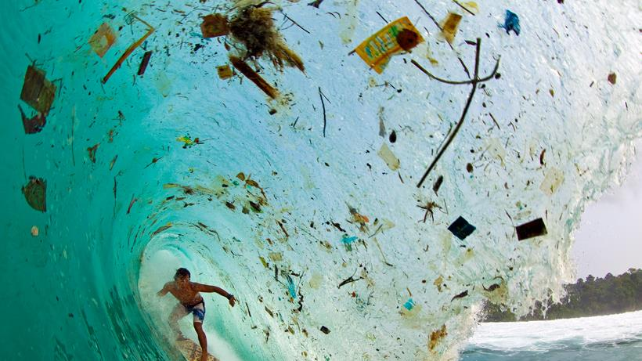
Is féidir le plaisteach tocsainí sna haigéin a shú isteach
Notes:
Not only are the plastics themselves toxic, but some also act as sponges for other toxins. Certain plastics can absorb toxic chemicals, making them even more dangerous to the marine life that accidentally or intentionally eat them. Unfortunately the most commonly produced plastics absorb the most chemicals. Some plastics can continue to absorb organic pollutants for months after reaching marine environments. One scientific study estimated it would take 44 months for high-density polyethylene to stop absorbing certain toxic chemicals. As the plastic continues to degrade, it’s potentially getting more and more hazardous to organisms as they absorb more and more contaminants.
*Study mentioned: Rochman et al 2013 Long-Term Field Measurement of Sorption of Organic Contaminants to Five Types of Plastic Pellets: Implications for Plastic Marine Debris. Environmental Science & Technology

Slide 22
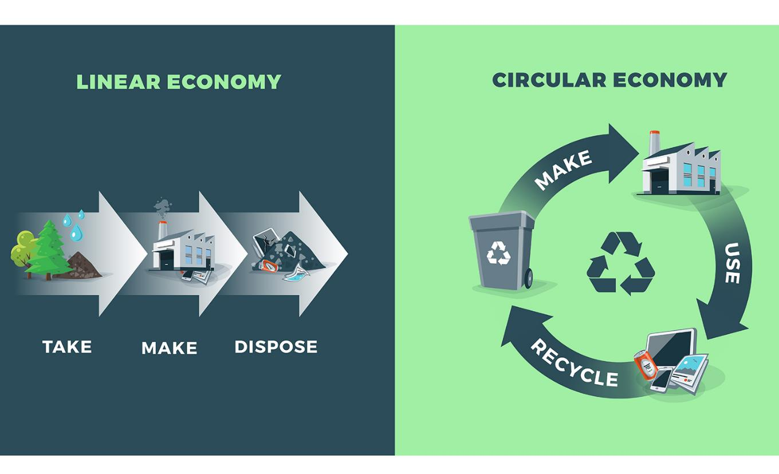
Céard í fuascailt na faidhbe?
An geilleagar líneach
An geilleagar ciorclach
DÉAN
ÚSÁID
TÓG
DÉAN
DIÚSCAIR
ATHCHÚRSÁIL
Notes:
The old way of thinking was to make something, use it and throw it away. But this creates so much waste, and uses a lot of energy.
A circular economy is an economic system designed to reduce waste and make the most of resources. Products are designed to be long life and can be renewed, reused, repaired, and upgraded.
Source: https://www.instarmac.co.uk/linear-vs-circular-economy/

Slide 23
Céard is féidir leatsa a dhéanamh?
Úsáid níos lú táirgí plaisteacha
Fan glan ar phlaistigh aonúsáide
Athchúrsáil
Cuir tú féin agus daoine eile ar an eolas
Glac páirt i nglantacháin trá
Scríobh chuig comhairleoirí agus teachtaí dála
Notes:
Come up with a list of actions that you, and the school community can do to help prevent or reduce your plastic waste

Slide 24
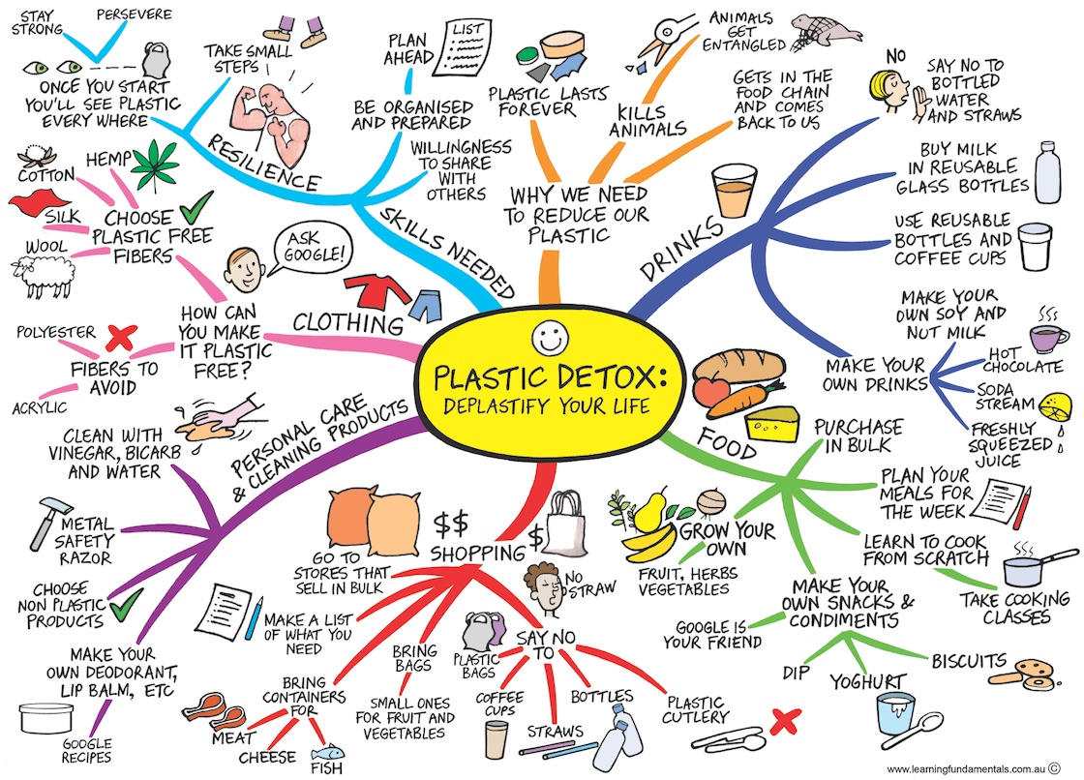
Notes:
Source: http://www.plasticfreejuly.org/uploads/1/3/4/9/13493602/plastics_mindmap_1.jpg

Slide 25
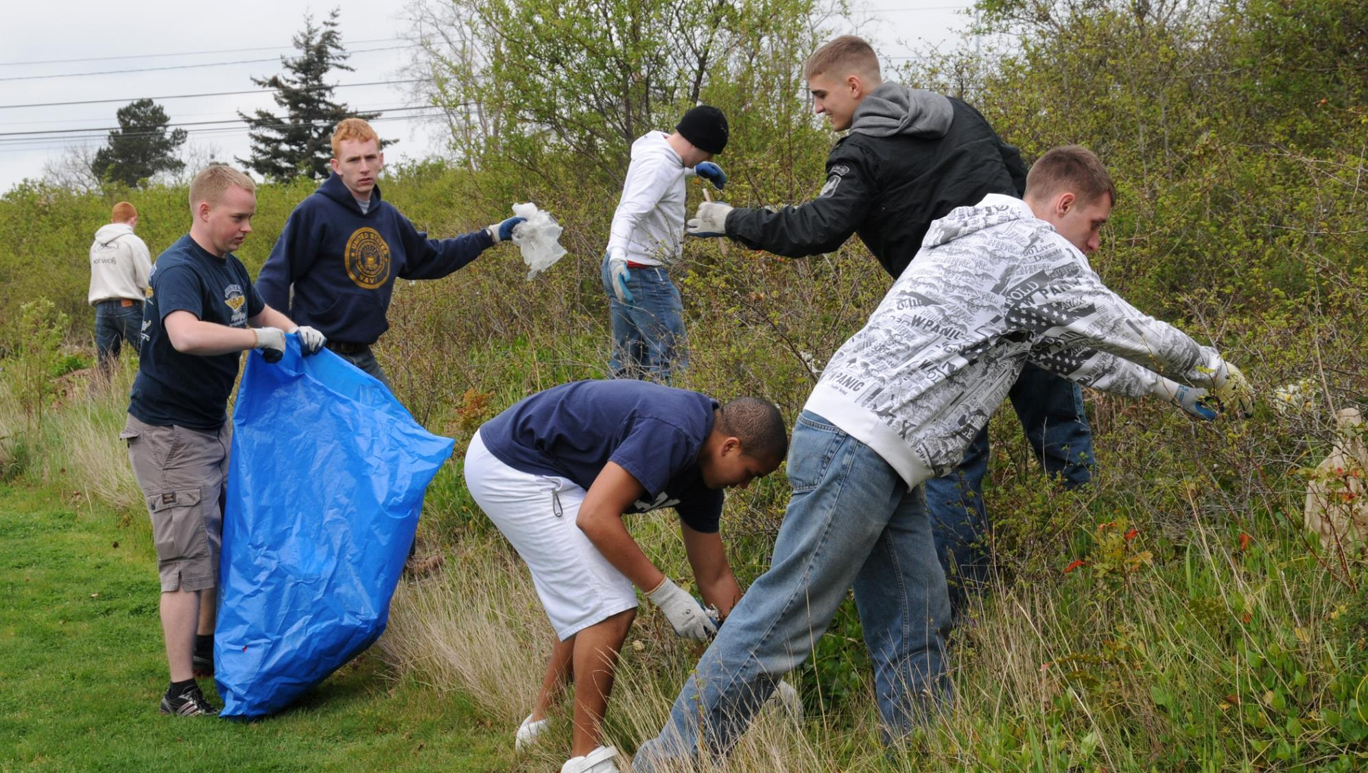
Gníomhaíochtaí

Slide 26

Cláraigh do scoil mar Ghrúpa Cóstaí Glana
Glac caomhnóireacht ar stráice de thrá áitiúil
Eagraigh imeachtaí glantacháin
Laghdaigh tionchar an bhruscair mhuirí ar an gcomhshaol
Cosain go gníomhach láithreáin atá tábhachtach ó thaobh na bithéagsúlachta de
Feabhsaigh do mheabhairshláinte agus do shláinte choirp

Slide 27



Fiosraigh cad is brí leis na siombailí coitianta pacáistithe seo? Cuir pobal uile na scoile ar an eolas
Notes:
Answers can be found at https://repak.ie/for-home/recycling-symbols/

Slide 28

Dear póstaer d’fhonn feasacht ar an dramhaíl phlaisteach a mhéadú i do scoil
Notes:
Run a competition in your school for the most eye catching poster! This will spark more interest from the school community and allow you to highlight your plastic reduction campaign.

Slide 29

Físeáin
What is plastic and how is it made https://thekidshouldseethis.com/post/plastics-101-what-is-plastic-and-how-is-it-made
Kids take action against Ocean Plastic https://www.youtube.com/watch?v=hKFV9IquMXA
Circular Economy https://youtu.be/zCRKvDyyHmI
A brief history of plastics https://www.youtube.com/watch?v=QW3OGMZ1bWc
Clean Coasts Video https://www.facebook.com/CleanCoasts/videos/clean-coasts-do-good-feel-good/10160489289715716/
Plastic Oceans- the Riptide Movement https://www.facebook.com/TheRiptideMovement/videos/plastic-oceans-episode-1-riptide-movement-with-clean-coasts/415287392340570/
Notes:
Encourage teachers to show these videos in class
Play these videos in the school canteen or common areas for all students to see
Organise a movie morning/afternoon/night and play a feature length documentary about plastic waste and/or marine litter. Sell sustainable snacks at the event to raise money for the Green-Schools activities.
Highlight videos of interest in an email/newsletter/soial media post so that all members of the school community can access the information

Slide 30
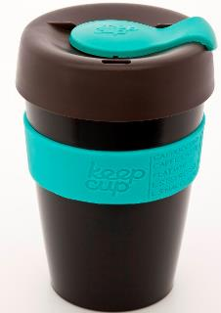
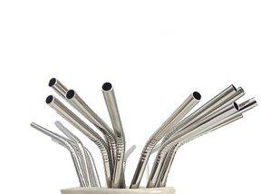
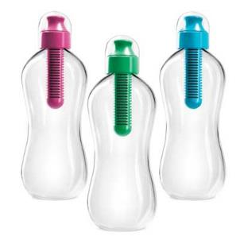
Cuir pobal na scoile ar an eolas faoi na roghanna eile is féidir a úsáid in ionad plaistigh aonúsáide
Notes:
Is there a change you can make in your school? Could you start a campaign to get rid of plastic bottles?
For more information check out our plastic free booklet for tips on reducing plastic in your personal life, in clubs and in schools.

Slide 31
Déan iarracht gan plaisteach a úsáid go ceann lae, seachtaine nó míosa fiú!
Cuir an feachtas chun cinn sa scoil
Spreag múinteoirí agus daltaí eile le bheith páirteach san fheachtas
Doiciméadaigh an próiseas ar fad, idir mhaith agus olc, ar na meáin shóisialta
Cruthaigh ábhar físe ionas gur féidir le daoine coimeád suas le d’aistear
Notes:
Ban plastic from your life! How long will you last? Is it even possible to avoid plastic? Document your journey to highlight the highs and lows of a life without plastic. Encourage others to sign up.

Slide 32
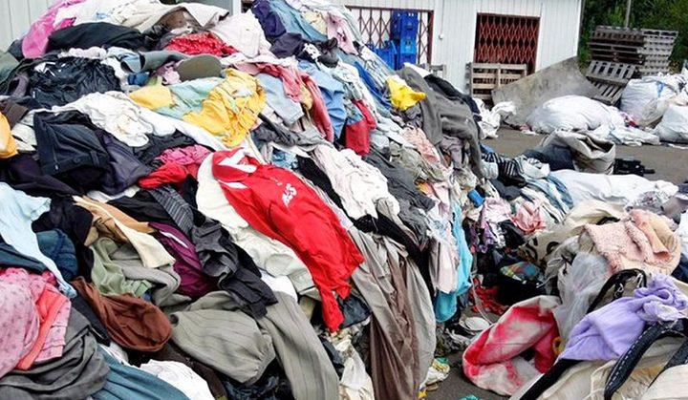
Déan tionscadal taighde.
Ábhar molta: An Mearfhaisean
Is éard atá i gceist leis an mearfhaisean ná i bhfad níos mó bailiúcháin faisin nua gach bliain, séasúir níos giorra agus praghsanna níos ísle den chuid is mó.
https://www.youtube.com/watch?v=ECkLgq2W9RU
Notes:
While fast fashion clothing may not cost the consumer much, it comes at a high price. The real cost of a €5 t-shirt lies in the low wages, dangerous working conditions and environmental harm.
Research fast fashion and educate your school community on this important waste problem.

Slide 33


Brúigh an t-athrú chun cinn!
Notes:
CSPE: Rights and responsibilities, interdependence, stewardship
Environmental and Social Studies: People in their environment, the modern world
Geography: Exploring how we interact with he physical world, exploring people, place and change, sustainability
Science: Chemical world, biological world

